Slide 1
JVM memory management

Slide 2
JVM memory types
Heap
Stack
JVM internal

Slide 3
Heap
Heap contains all the objects created by JVM.
Garbage collection runs on heap memory.
Heap memory is global – can be accessed from anywhere of the application.

Slide 4
Stack
Stack memory is used for execution of a thread.
Stack acts in LIFO order.
Stack holds local variables in a method(primitive values and reference to other objects in the method).

Slide 5
Stack and Heap
Method Area : https://docs.oracle.com/javase/specs/jvms/se7/html/jvms-2.html#jvms-2.5.4

Slide 6
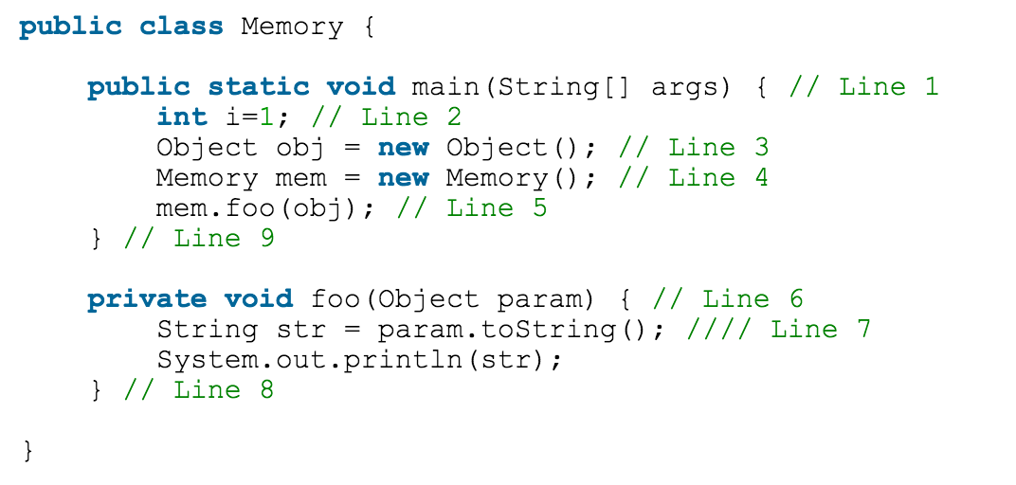

Slide 7
Difference Between Heap and Stack
Heap is global for the whole app. Stack is used inside thread execution.
Heap keeps the object, Stack has the reference.
Stack is just a LIFO structure. Heap is divided into multiple area(young generation, old generation).
Stack is short-lived vs Heap ends with the app.
If stack is full it throws java.lang.StackOverFlowError, If heap is full it throws java.lang.OutOfMemoryError
Stack is smaller than heap

Slide 8
Resize JVM Memory
We use –Xms, -Xmx option to define the startup size and maximum size of heap memory.
-Xss to define the stack memory size
Example: Java –Xms128m –Xmx1024m –Xss16m HelloWorld
This will define the JVM to run HellowWorld.class file using initially 128mb and up to 1024mb heap memory and 16mb stack memory.

